Slide 1
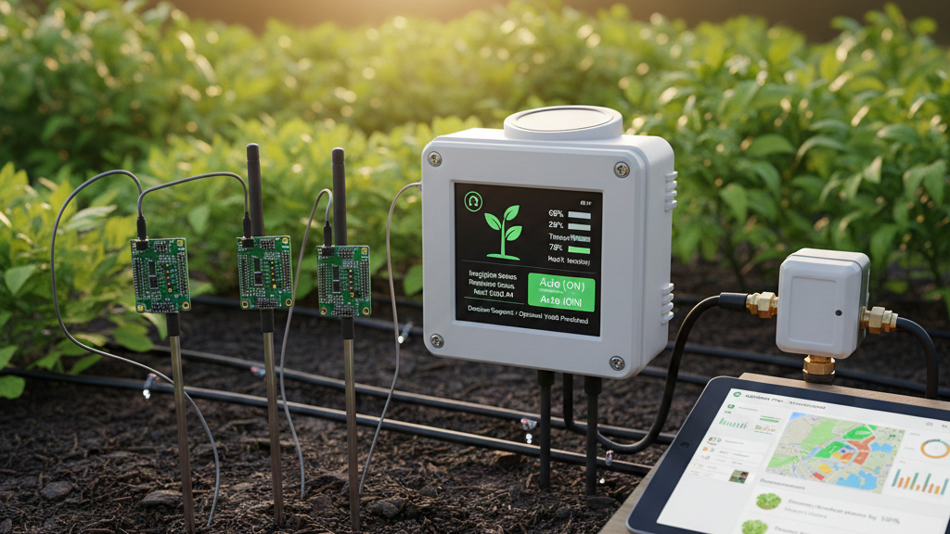
IoT-Based SoIl MoIsture MonItorIng & DecIsIon System
YAĞIZ SELİM SAĞLAM 231023223
SÜLEYMAN İNCE 221023206
EMRE YILDIZ 201023005

Slide 2
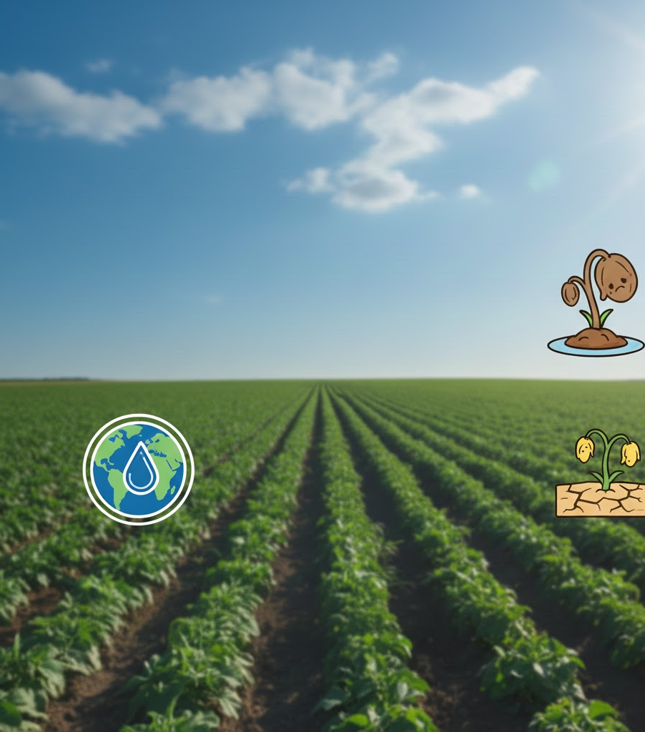
Problem DefInItIon & MotIvatIon
The Motivation: Agriculture accounts for 70% of freshwater use; inefficient irrigation wastes a significant portion.
The Risks:
Overwatering: Leads to root rot, nutrient leaching, and fungal growth.
Underwatering: Causes permanent wilting and significant crop yield loss.
The Goal: To move from "scheduled watering" to "data-driven irrigation" using an automated decision system.

Slide 3
System OvervIew
The Decision Architecture:
Data Layer: Capacitive sensors measure soil dielectric constants at regular intervals.
Logic Layer: A supervised Machine Learning model classifies soil status.
Action Layer: Real-time "Water Now" alerts sent to a cloud-hosted dashboard.
Deployment: End-to-end integration from Microcontroller → AWS Cloud →Streamlit UI.

Slide 4
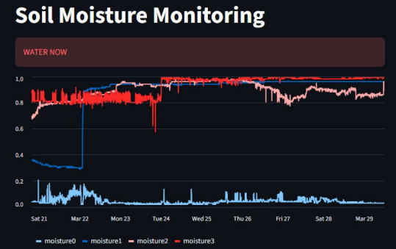
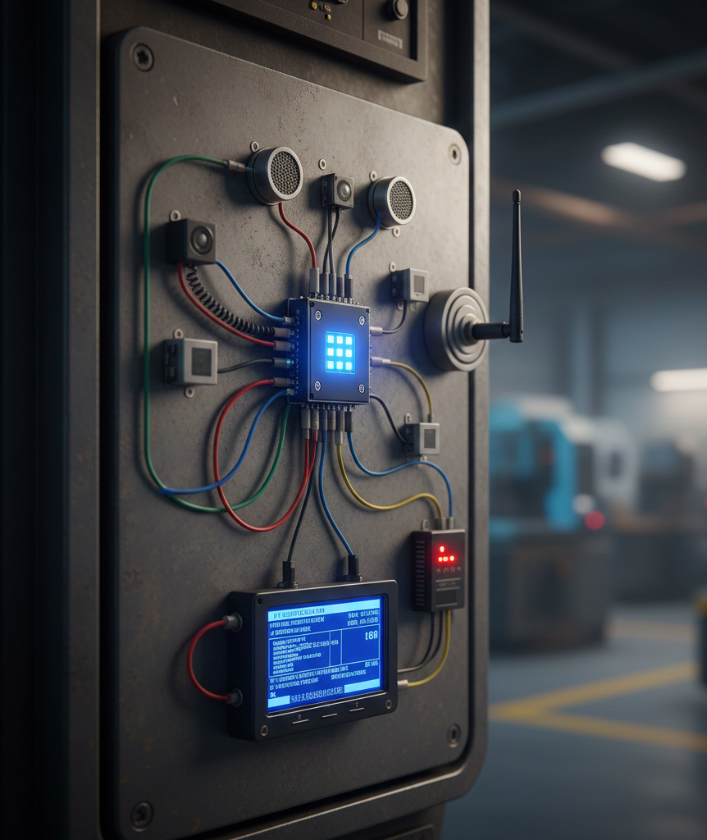
Sensors & Data CollectIon
Hardware and Experimental Setup:
Capacitive Sensors: Chosen for durability and corrosion resistance.
The Array:
Moisture0: Control group (soil only) to measure baseline evaporation.
Moisture1–3: Active monitoring of diverse indoor plants.
Data Normalization: Raw analog signals mapped to a standardized 0–100% scale.

Slide 5
MachIne LearnIng & DecIsIon LogIc
Turning Data into Decisions:
Model: Supervised Binary Classification (Water Needed vs. Healthy).
Target: Accurate identification of low-moisture conditions before stress occurs.
Logic: The system utilizes trend analysis—detecting the rate of moisture loss rather than just a static threshold.
Success Metrics: High F1-score and reliability in noisy environments.

Slide 6

Dashboard & Deployment
Remote Monitoring via AWS:
Engine: Built with Streamlit for real-time visualization.
Cloud Infrastructure: Hosted on AWS EC2 for global accessibility.
Features:
Live time-series moisture graphs.
Public access via Port 8501.
Visual status indicators for each plant pot.

Slide 7
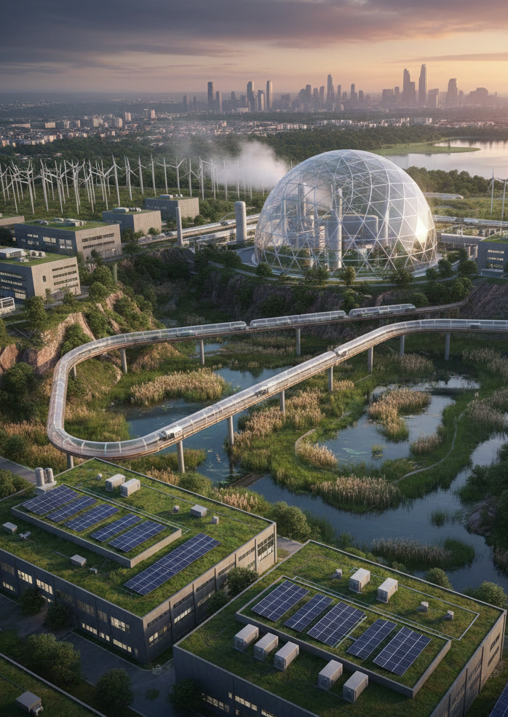
ConstraInts & Challenges
Engineering Considerations:
Sensor Noise: Filtering fluctuations caused by temperature and soil salinity.
Microcontroller Limits: Optimizing code for low memory and processing power.
Connectivity: Managing network delays and ensuring data integrity during transmission.
Power: Balancing measurement frequency with battery/power consumption.

Slide 8
ConclusIon & Future Work
Final Results:
Achieved a reliable, automated alerting system for indoor plant care.
Reduced the risk of plant loss through data-driven notifications. Next Steps:
Adaptive Thresholds: ML that learns the specific needs of different plant species.
Closed-Loop Control: Integrating water pumps for fully autonomous irrigation.
Mobile Integration: Adding push notifications via Telegram or SMS.

